Slide 1

School of Computing Science and Engineering
School of computer science and engineering
AI CHATBOT SYSTEM
Code Crafters (GUVI Name : CSE/Section-1/16)
TEAM MEMBERS:
Arya Atole – 23SCSE1011455 (Group Leader)
Sameer – 23SCSE1011909
Durgesh Giri – 23SCSE1012420
Abhishek Sharma – 23SCSE1012085
BTech CSE , Section – 1, Semester - 3

Slide 2
School of Computing Science and Engineering
School of computer science and engineering
CONTENT
Introduction
Problem statement and objective
System Architecture
Backend Tech
Ai Integration
Frontend Tech
Key Features
Benefits
Use Cases
Conclusion
BTech CSE , Section – 1, Semester - 3

Slide 3
School of Computing Science and Engineering
School of computer science and engineering
INTRODUCTION
Introducing to our AI chatbot system which is built using Java and Spring Boot for backend logic and user management, combined with Node.js for handling real-time communication and integration with AI services. It leverages AI models like GPT for natural language understanding, allowing it to respond intelligently to user queries. The frontend, designed using HTML, CSS, and JavaScript, offers a smooth, responsive user experience across devices. This system is scalable and efficient, providing real-time, AI-driven conversations with features like user authentication and session management, making it ideal for customer support and other interactive applications.
BTech CSE , Section – 1, Semester - 3

Slide 4
School of Computing Science and Engineering
School of computer science and engineering
PROBLEM STATEMENT AND OBJECTIVE
The problem this project addresses is the need for an efficient, automated system to handle user queries and support tasks in real time, reducing the dependency on human agents for repetitive or straightforward interactions. The objective of the AI chatbot system is to provide a scalable, AI-driven conversational platform that can understand and respond to user inputs intelligently, using natural language processing. By leveraging technologies like Java, Spring Boot, and Node.js, the system aims to enhance user experience, improve response times, and offer 24/7 support across multiple platforms.
BTech CSE , Section – 1, Semester - 3

Slide 5
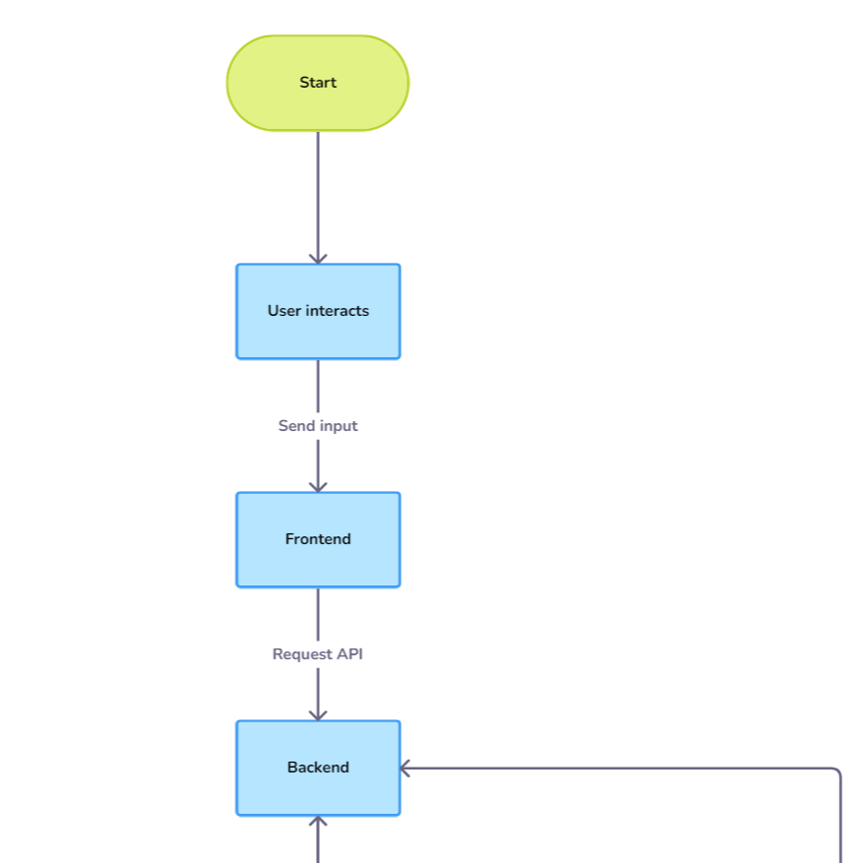
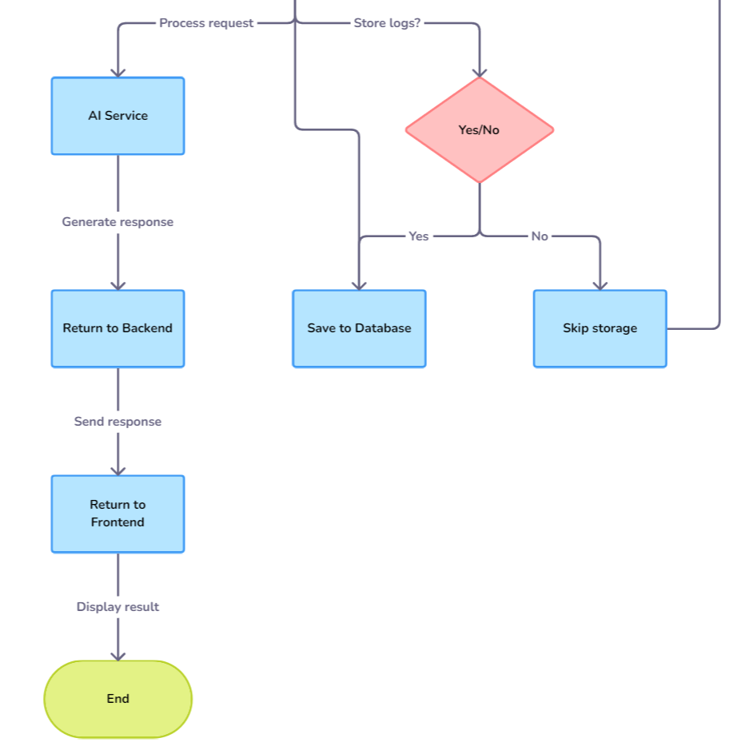
School of Computing Science and Engineering
School of computer science and engineering
SYSTEM ARCHITECTURE
BTech CSE , Section – 1, Semester - 3

Slide 6
School of Computing Science and Engineering
School of computer science and engineering
BACKEND TECH
Java & Spring Boot:
Node.js:
Used for building RESTful APIs and managing the core application logic.
Handles user authentication, session management, and routing of requests.
Spring Boot simplifies the configuration and deployment process.
Acts as an intermediary for real-time communication and event handling.
Manages external AI service integration for dynamic responses.
Handles asynchronous tasks efficiently, improving performance and responsiveness.
BTech CSE , Section – 1, Semester - 3

Slide 7
School of Computing Science and Engineering
School of computer science and engineering
AI Integration
Natural Language Processing (NLP):
Features:
The chatbot uses AI models like GPT or other NLP services to process user queries and generate meaningful responses.
This enables the chatbot to understand the context of conversations, offering human-like dialogue.
Contextual Responses: AI ensures that the bot understands the context of a conversation and maintains coherent interactions.
Error Handling: The bot can handle errors in user input and ask clarifying questions.
Learning from Interactions: Ability to improve responses over time through interaction data analysis.
BTech CSE , Section – 1, Semester - 3

Slide 8
School of Computing Science and Engineering
School of computer science and engineering
FRONTEND TECH
HTML, CSS, JavaScript:
Responsive Designs:
HTML: Provides the structure for the chatbot interface, allowing users to easily input queries.
CSS: Responsible for the design, ensuring a user-friendly, visually appealing interface that adapts to various screen sizes.
JavaScript: Handles dynamic interactions, such as sending user queries to the backend and updating the UI with chatbot responses in real time.
Ensures the chatbot works seamlessly across devices (desktops, tablets, and smartphones), providing an optimal user experience.
BTech CSE , Section – 1, Semester - 3

Slide 9
School of Computing Science and Engineering
School of computer science and engineering
KEY FEATURES
Instant response to user queries through asynchronous communication between frontend and backend
Intelligent AI driven responses generated using NLP models integrated into the backend
The system is built to handle a large volume of queries simultaneously, making it suitable for enterprise-level applications.
The chatbot is accessible on multiple devices, thanks to its responsive design.
BTech CSE , Section – 1, Semester - 3

Slide 10
School of Computing Science and Engineering
School of computer science and engineering
BENEFITS
Automates repetitive tasks and reduces human involvement, allowing businesses to focus on more complex issues.
Unlike human agents, the chatbot is available around the clock for 24X7 time, providing users with constant support.
Reduces the need for large customer service teams , lowering Operational costs.
Provides instant, accurate responses, resulting in higher user satisfaction.
BTech CSE , Section – 1, Semester - 3

Slide 11
School of Computing Science and Engineering
School of computer science and engineering
USE CASES
Customer Support
E-commerce
HealthCare
Education
BTech CSE , Section – 1, Semester - 3

Slide 12
School of Computing Science and Engineering
School of computer science and engineering
CONCLUSION
This AI chatbot system combines powerful backend and frontend technologies to offer real-time, intelligent conversations. Its scalable architecture makes it suitable for a range of applications, from customer support to personalized recommendations.
BTech CSE , Section – 1, Semester - 3

